Slide 1
SEASaw
Youtube videos indexed by frame contents

Slide 2





Problem:
Youtube bases search results on video meta-data (title, description, popularity algorithms, etc)
Unseemly types have used this to their advantage to “game” the system and prioritize unrelated content.
Increasing prevalence of “clickbait”.

Slide 3
Solution:
Use frame data from the video in the index.
Videos that contain objects relevant to the search term are prioritized

Slide 4
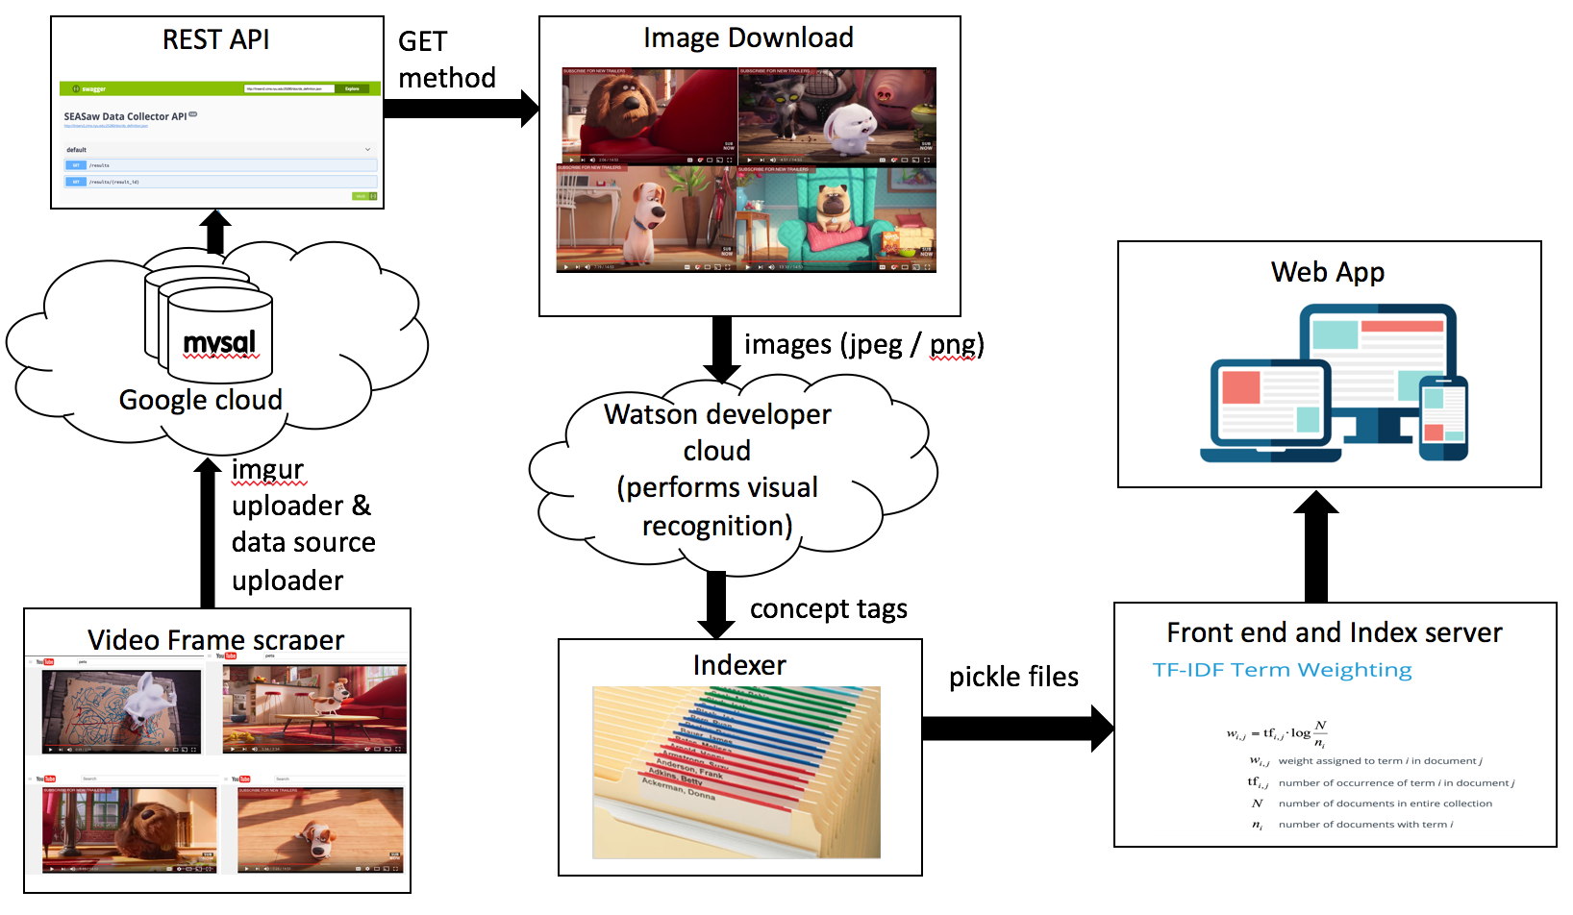
Architecture

Slide 5
Scraper
Selenium / Geckodriver / Firefox
Searches Youtube from randomly selected word (list of animals)
Breadth-First Traversal through results and “related videos”

Slide 6
Persisting
Frames stored on imgur
Results all stored on Google Cloud
Multiprocessing

Slide 7
API
Simple RESTful API used to get data from the datastore
Running on Tornado
Swagger

Slide 8
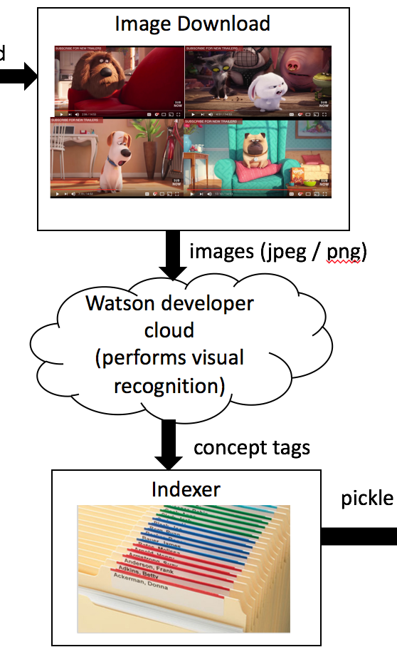
Image downloader
GET method of RESTful API to retrieve frame info from datastore
Urllib of python to save frames locally
Process image title
Saving format: video_title | result_id| frame_number

Slide 9
Visual recognition
Watson developer cloud provides visual recognition service to classify frames
Image prerequisites
Parameters to classifier –api-key, image_file
Response

Slide 10
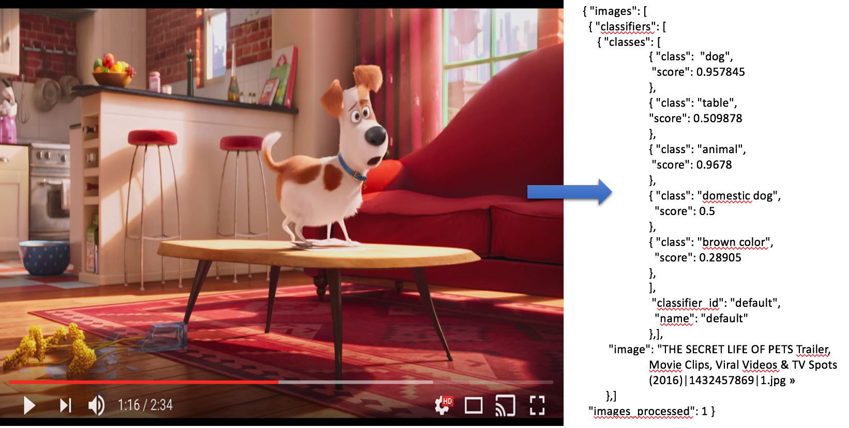
Sample Response from visual recognition

Slide 11
Indexer
Input: classified dictionary data with tags
Output 2 pickle files:
Inverted Index for each partition
List of result_ids of processed videos

Slide 12
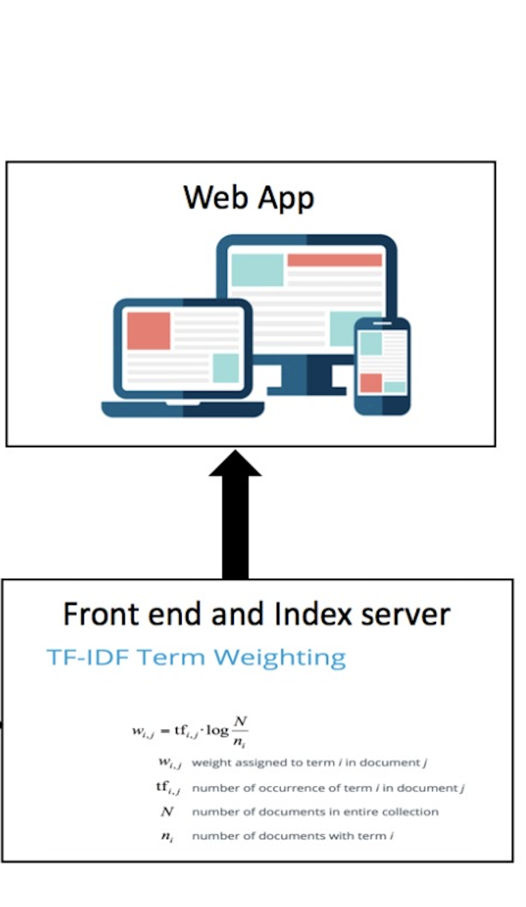
Frontend
Loads data from pickle files, combine inverted indexes
Get IDF and calculate score tf-idf for each term
sort the result ids by score and get best ids
pickle

Slide 13
Frontend
Get detailed video information from datasource server using result ids
title, tags, url, frames, and timestamps
Generate html code displaying result
pickle

Slide 14
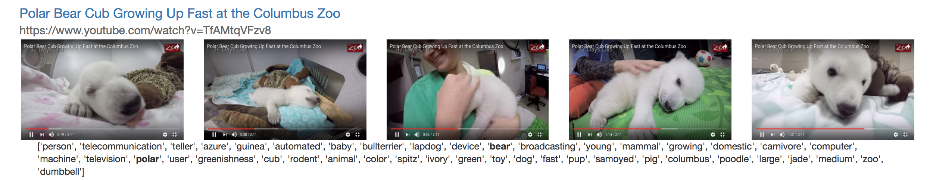
Sample output
video title
video url
frame images
tags for video

Slide 15

Challenges
“Free-tier” API Limits.
Incomplete libraries
Youtube Ads causing problems in the data
Watson’s limit to process 250 images a day
Can’t process images whose title has emoji’s
Does not support parallel processing

Slide 16

Demo time…

